Slide 1
Launching
R-Ladies ChaRlottesville
library(dplyr)
rladies_global %>%
filter(city == 'Charlottesville')
Pick up a temporary parking pass!
Wifi: VividCortex_Guest
Fill out the survey if you haven’t already: https://goo.gl/oa1mJU
Follow us on Twitter: @RLadiesCville
November 14, 2017

Slide 2

Welcome!
You’re in the right place.
Whether you’re a R novice or R expert, this group is for you!
Notes:
Ask about experience
Fix hand

Slide 3
Agenda for today:
Introductions
What is R-Ladies?
Why R?
How to install and run R and R-Studio on your computer

Slide 4

1.
What is R-Ladies?

Slide 5

Worldwide organization
...that promotes gender diversity in the R community
...via meetups and mentorship
...in a friendly and safe environment
Notes:
How did I find out about it?
What is it doing now?
Who is interested in it? CelebRities

Slide 6
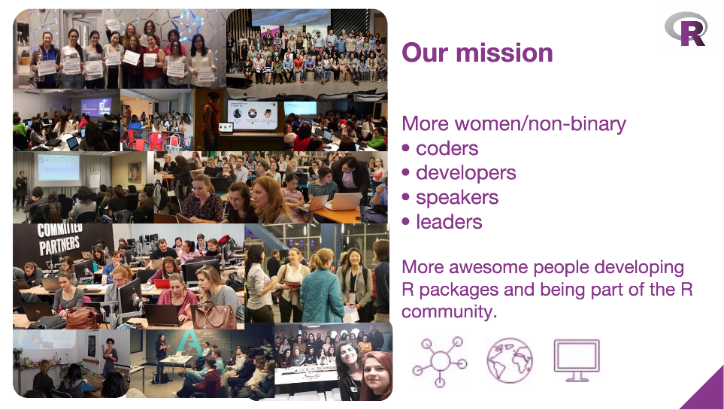
From R-Ladies Global, useR 2017 presentation

Slide 7
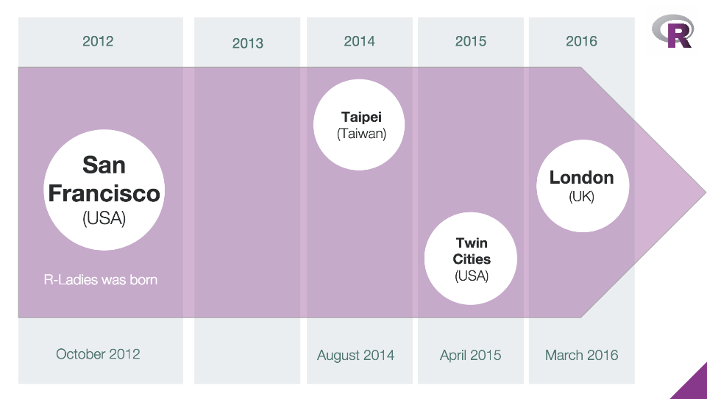
2017: C-Ville
From R-Ladies Global, useR 2017 presentation

Slide 8

2.
Why R-Ladies Charlottesville?

Slide 9
R-Ladies Charlottesville
Goals
Teach and learn R
Expand professional network
Meet amazing women
Get involved in the wider R community
Get involved in local tech community
Plans for the future
Monthly Meetups:
Presentations, workshops
Networking and events
RLadiesCville website!
More 🍕🍕🍕

Slide 10




Sponsors + Friends (for now)
Look at all of this empty space!

Slide 11
It’s your group

Slide 12
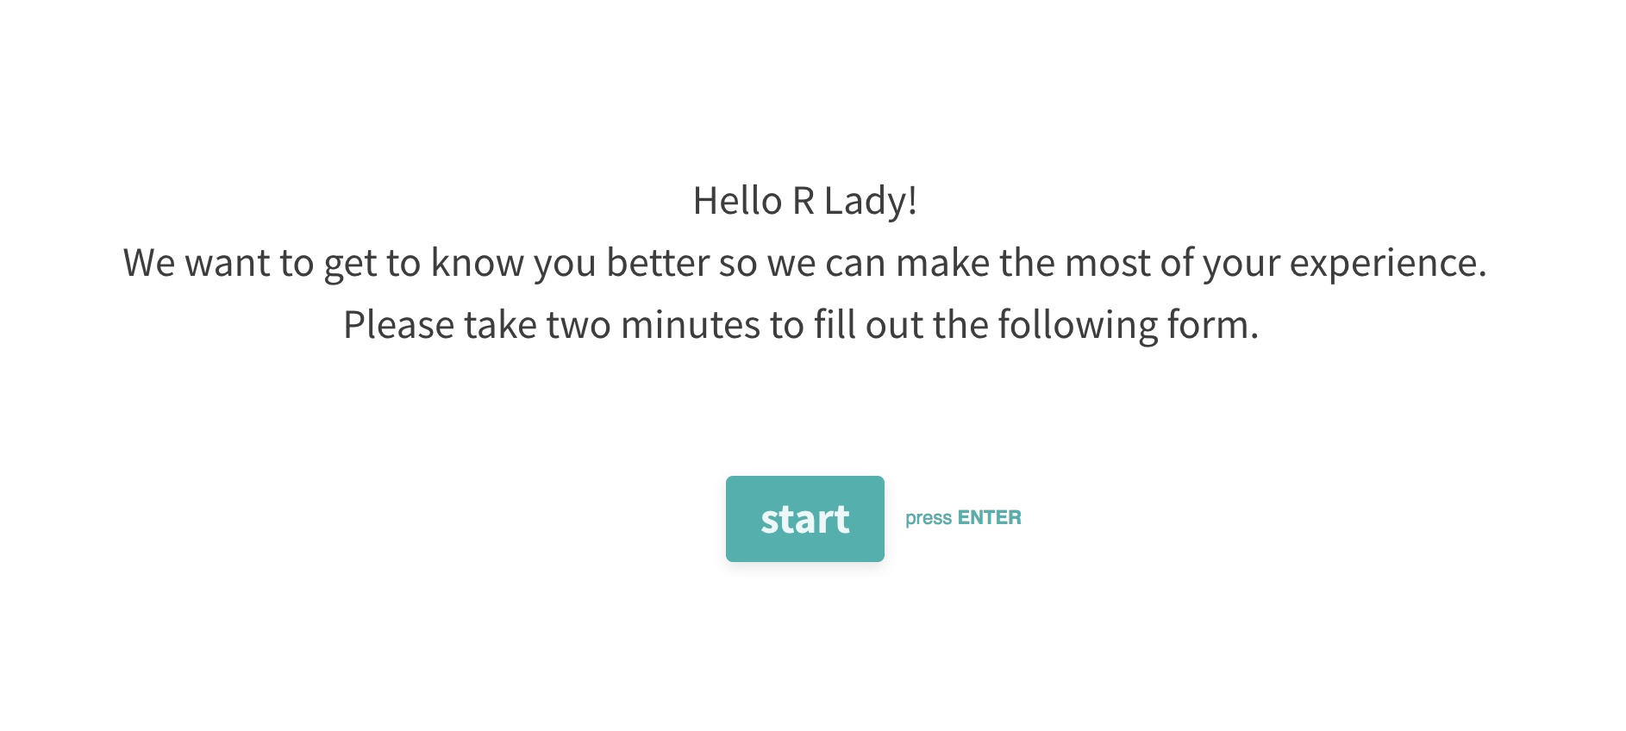
https://goo.gl/oa1mJU

Slide 13

3.
What can you do?

Slide 14
Tell your friends

Slide 15
Get involved
Learn
Join our Meetup page and attend events
Follow us on Twitter @RLadiesCville
Contribute
Join our GitHub page
Slack channel?
Ask questions
Organize
Lead a workshop
Give a talk
Ask your company to sponsor us
Be a co-organizer!

Slide 16
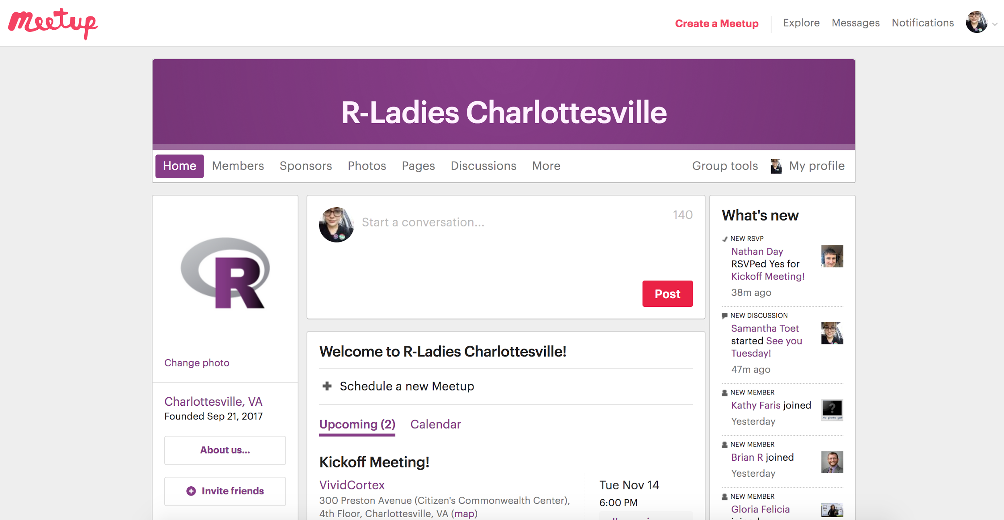
Find us online!
Website: https://rladies.org
Want to help create an R-Ladies Charlottesville site?
Twitter: @RLadiesCville
Meetup: https://www.meetup.com/rladies-charlottesville/
Github: https://github.com/rladies-charlottesville
Slides to be posted here
Check out the R crossword puzzle from RLadiesDC!
Email: charlottesville@rladies.org/ samantha@rladies.org

Slide 17

4.
How to install and run R and RStudio

Slide 18

R + Rstudio =
R is a language and environment for statistical computing and graphics
Rstudio is an integrated development environment (IDE) for R; it’s where the magic happens
CRAN (Comprehensive R Archive Network) is where you can download R and all of the compatible R packages

Slide 19
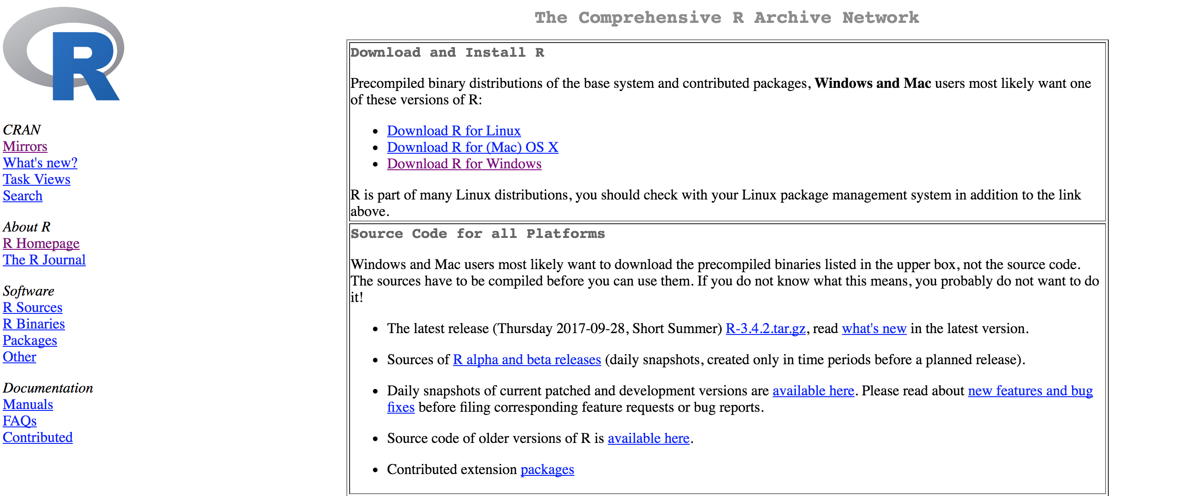
Step 1: Download R from CRAN
Go to https://cran.r-project.org/ and download the version that is compatible with your OS
http://web.cs.ucla.edu/~gulzar/rstudio/index.html

Slide 20
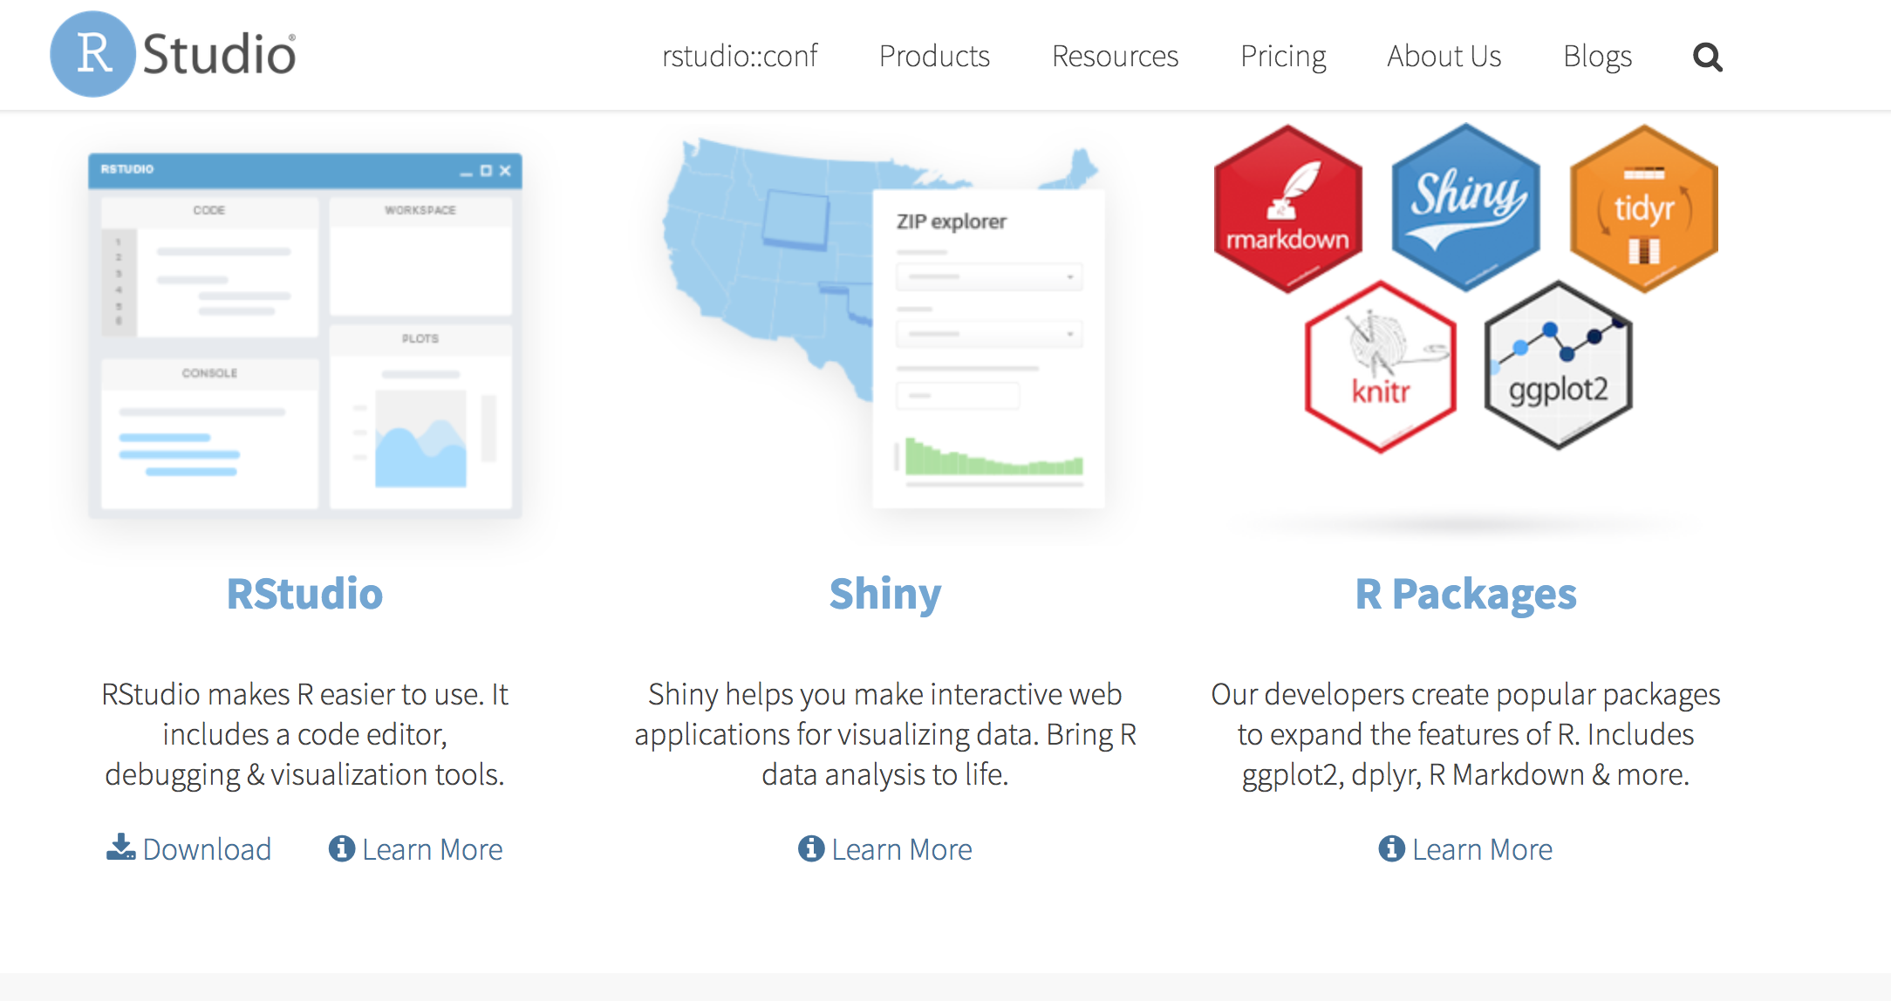
Step 2: Download Rstudio
Go to https://www.rstudio.org /and download the newest version of Rstudio (make sure to download the FREE version)
http://web.cs.ucla.edu/~gulzar/rstudio/index.html

Slide 21
Step 3: Have fun and make lots of mistakes!
Check out rbloggers.com for more info on R
Follow us on Twitter! @RladiesCville
Join us on GitHub!
Next session: intro to dplyr & ggplot2
Future topics: into to Git, pipes, R-Ladies Cville website, Open Data, intro to Shiny, intro to Markdown, more tidyverse?
Thanks!!

